Slide 1
Superstore Sales Analysis SHIPFAST LOGISTICS
By Atul Gaikwad
TOOL: GOGGLE LOOKER STUDIO

Slide 2
Background Information
ShipFast Logistics is a leading logistics company in India, facing challenges in managing shipments efficiently across diverse Indian geography. The company has hired me to optimize the shipment process by analyzing order shipment data. The goal is to improve delivery times and reduce costs, which are critical for customer satisfaction and profitability.

Slide 3
Problem Statement
The key problem areas are: - Delays in shipments causing loss of customer satisfaction. - High shipping costs due to inefficient route planning. - Need for better performance metrics to identify optimization opportunities.

Slide 4
Data Analysis Approach
Our approach to solving these issues included:
1. Analyzing shipment data to identify delays and trends.
2. Developing key metrics such as average shipping time, number of orders per customer, and on-time shipment rates.
3. Visualizing data through dashboards and reports to pinpoint areas of improvement.

Slide 5
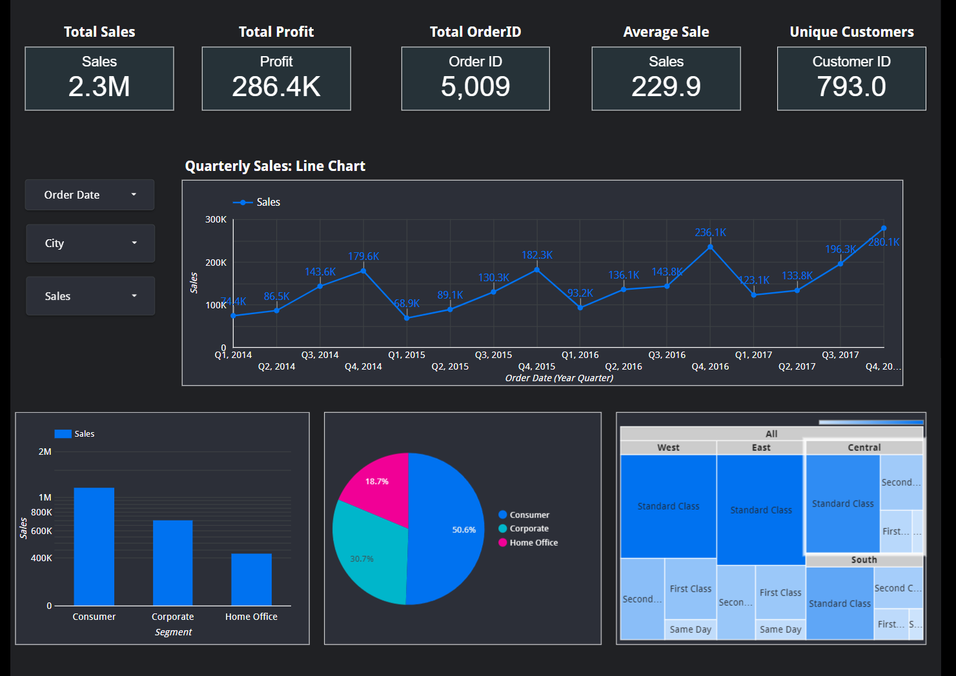

Slide 6
Key Metrics Overview
Key metrics we analyzed included: -
**Total Sales**: $2.3 million, providing insight into revenue performance. –
**Total Profit**: $286,400, guiding financial planning and cost improvements. –
**Total Orders**: 5,009, used for capacity planning and identifying order trends. –
**Unique Customers**: 793, helps in customer segmentation and targeting strategies. –
**Average Sale**: $229.90, assisting in pricing strategy and revenue optimization.

Slide 7
Quarterly Sales Analysis
Quarterly sales from 2014 to 2017 show a clear upward trend, with significant peaks in Q3 2014 and Q3 2016, indicating potential seasonal effects or successful promotions. The analysis suggests a consistent growth pattern, which can guide inventory planning and marketing strategies for future quarters.

Slide 8
Sales Analysis by Segment
The sales are distributed across three main segments: - **Consumer**: $1.16M - **Corporate**: $706K - **Home Office**: $429K This distribution indicates a strong consumer base, with significant contributions from the corporate sector. It can guide resource allocation and customer targeting strategies.

Slide 9
Regional Sales Analysis
The sales distribution across regions: - **West**: $725K (31.6%) - **East**: $679K (29.5%) - **Central**: $501K (21.8%) - **South**: $391K (17.1%) This distribution helps in regional performance analysis and guides region-specific strategies to boost sales.

Slide 10
Dashboard Analysis
The dashboard provides a comprehensive view of sales trends, profit analysis, customer segmentation, and regional performance. Key insights derived include the impact of shipping modes, profitability by region, and efficiency of different segments.

Slide 11
Conclusion and Recommendations
The Superstore Sales Analysis reveals key insights for enhancing shipment processes and optimizing profitability: - Focus on high-performing regions to boost sales. - Reduce delays by optimizing routes and shipping methods. - Target marketing efforts on the growing consumer segment.

